Slide 1

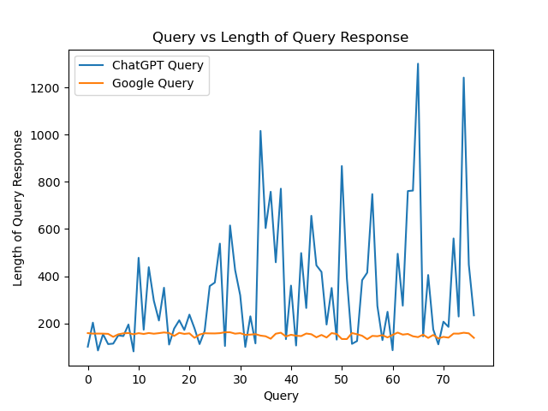
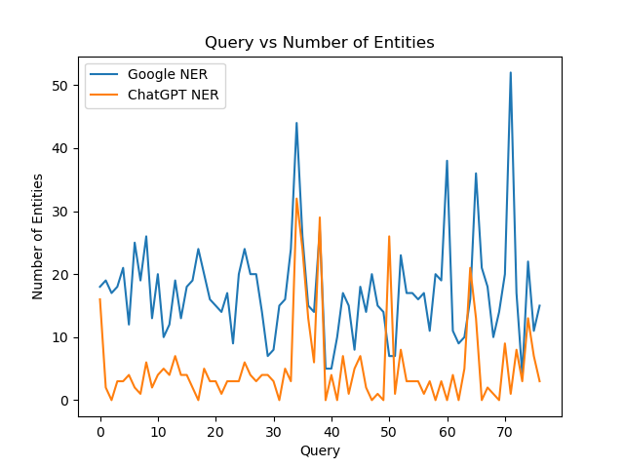
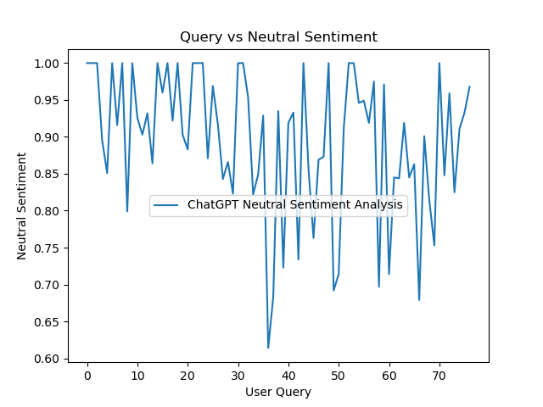
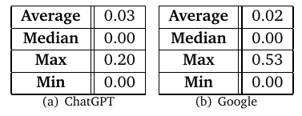
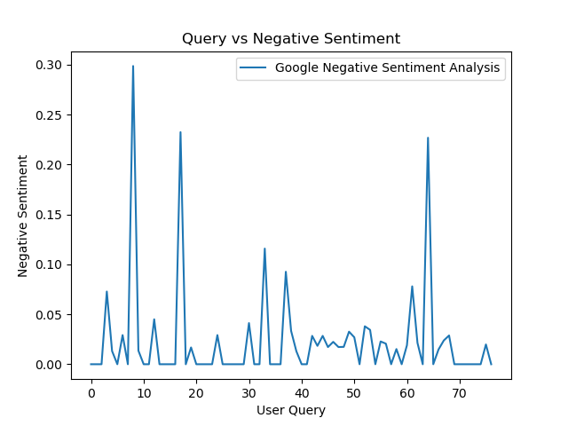
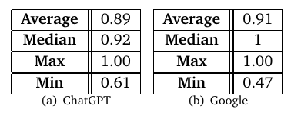
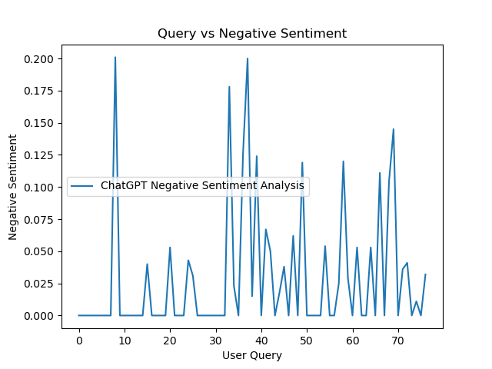
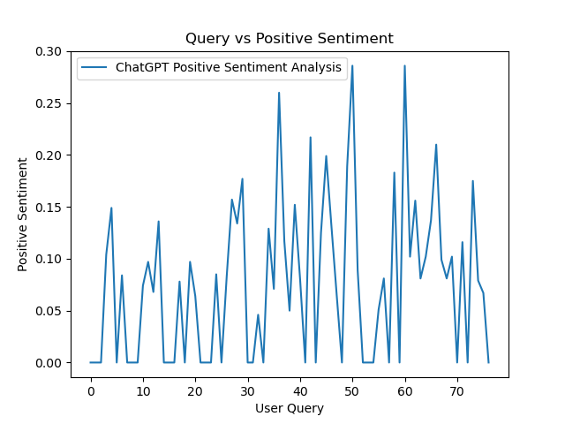
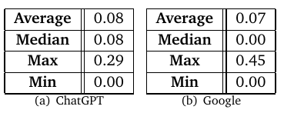
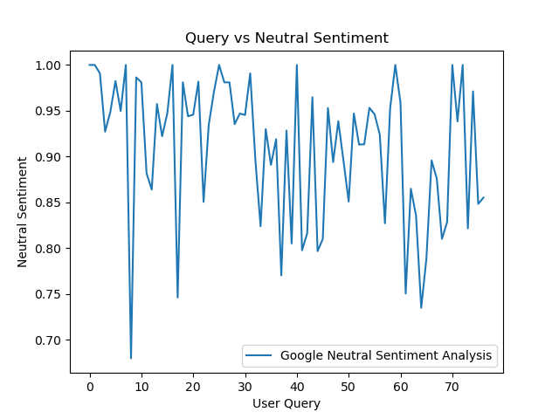
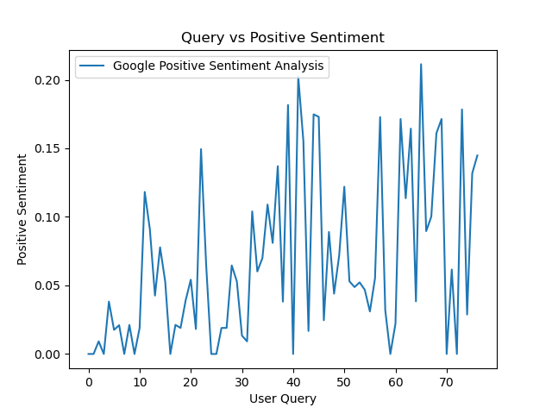
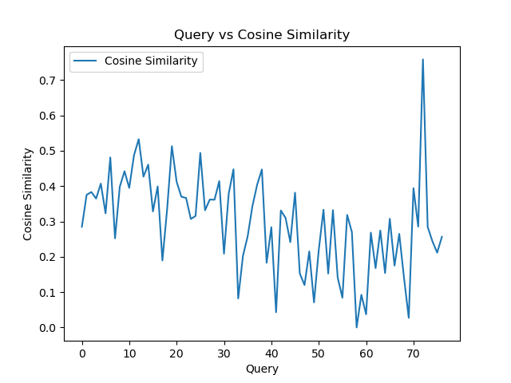
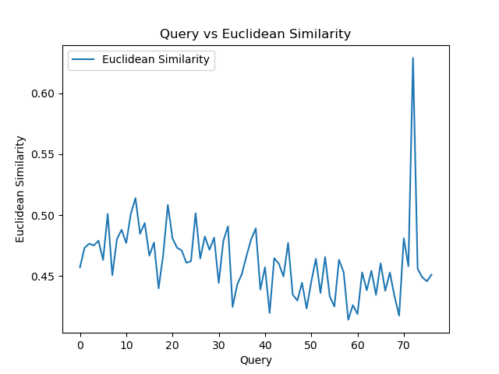

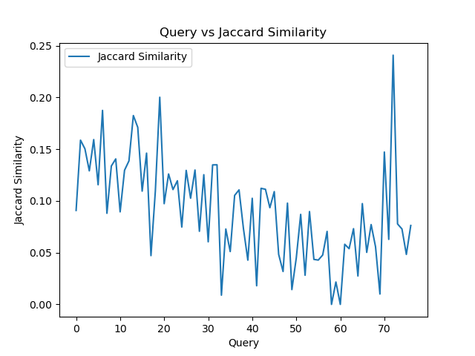
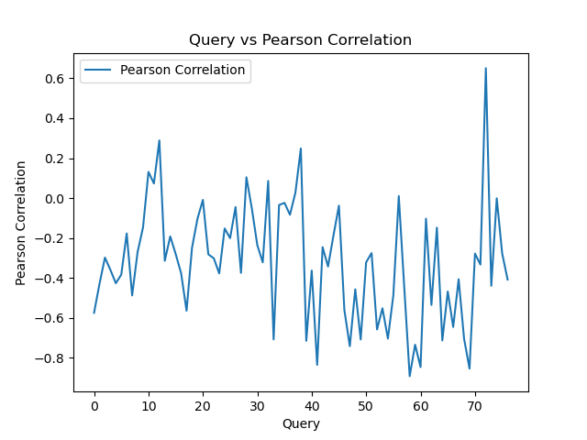


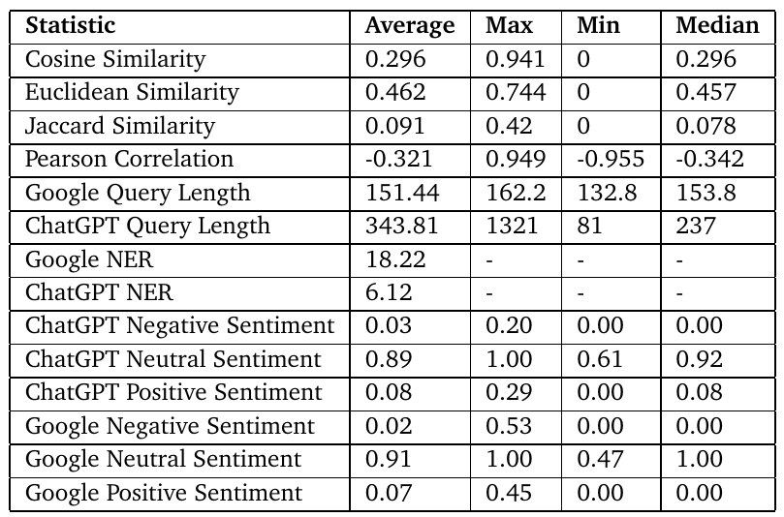
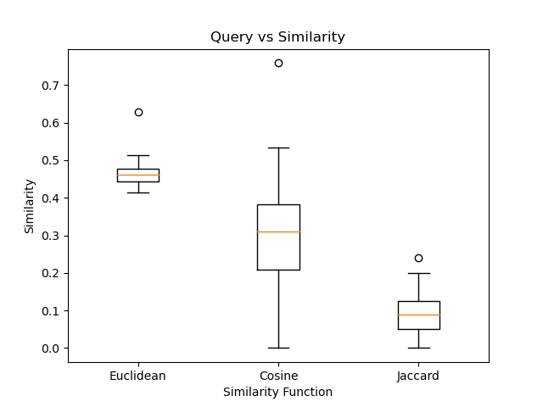
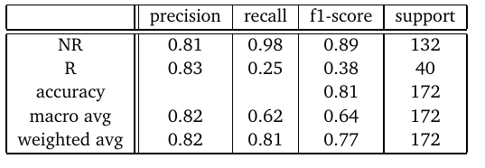
A Comparative Study between Google and Conversational AI Model
Student: Harkeerat Singh Sawhney
Advisor: Dr. Monica Landoni​
Motivation |  | Data Collection
The ubiquitous nature of the internet has led to a surge in online activity amongst young children. Along with that with new advancement of technology, we have both traditional search engines (Google Search) but also conversational AI Models (ChatGPT). This thesis aims to draw a comparative analysis between Google Search and ChatGPT but using different performance assessments. Along with that the thesis will also develop a machine learning model aimed to predict the relevance of a result from a search query. This is a research aimed thesis, in which the goal is to find out for children which is the best way to search for information online. The research question which this thesis aims to answer is “Are the new conversational AI models better for children to interact with, or do the traditional search engine still hold an edge over the new technology?” |  | Google Search API | ChatGPT API
Data Analysis
Query Length Analysis |  | Named Entity Recognition (NER)
Sentiment Analysis
Similarity Analysis
Findings and Limitations |  | Conclusion & Results
Children Search Query
Children Search Query
REST API Call
REST API Call
Google Search Engine
CSV Format
GPT-3.5-Turbo
CSV Format
JSON Response
Data Preprocessing
JSON Response
Data Preprocessing
Comparison between ChatGPT and Google Search:
ChatGPT's query lengths can vary based on the question asked, allowing for tailored responses.
Google tends to provide consistent query lengths, potentially indicating a focus on relevance and concise information delivery.
While ChatGPT's longer responses may offer more detailed explanations, they also carry a risk of information overload, whereas Google's consistent lengths may suggest greater relevance in its results.
Comparison between ChatGPT and Google Search:
Google Search yields a significantly higher average number of entities per search (18.2 vs. 6.11).
Both Google Search and ChatGPT commonly identify ORG, GPE, CARDINAL, and PERSON as top entities.
The presence of different entities (DATA in Google and LOC in ChatGPT) suggests potential variations in the information provided by each system.
Google's multiple search results contribute to the higher entity count, while ChatGPT's single generated response may lead to a lower count..
ChatGPT Sentiment
NEGATIVE SENTIMENT
Google Search Sentiment
NEUTRAL SENTIMENT
POSITIVE SENTIMENT
All the different Similarity Functions take ChatGPT Queries and Google Search Queries as their variables to which they try to find similarity between. Each sentence in each query is vectorized so that they are represented into a vector representation.
Cosine Similarity
Cosine Similarity is a measure of similarity between two non-zero vectors defined in an inner product space.
Euclidean Similarity
Euclidean Similarity is a measure used to determine the similarity or dissimilarity between two objects or data points in a Euclidean Space.
Jaccard Similarity
Jaccard Index Coefficient or also known as Critical Success Index, is measurement used to compute the similarity between two asymmetric binary variables.
Pearson Similarity
Pearson Correlation Coefficient is a measure of linear correlation between two sets of data. It is the ratio better the covariance of two variables with the product of their standard deviations.
Logistic Regression is the chosen model for binary classification, suitable for determining relevance.
F1 score, considering both precision and recall, is 0.89 for NR but low (0.38) for R.
Limited data poses a challenge for proper model evaluation.
Comparing results with ChatGPT, only 1 out of 77 queries was deemed relevant, indicating the need for more data collection and development.
From these initial results, we notice how currently Google Search provides more richness and consistency in its responses which are more suitable for children. However, ChatGPT is not far behind Google in the statistical evaluation and holds a lot of potential in the future.

